Slide 1
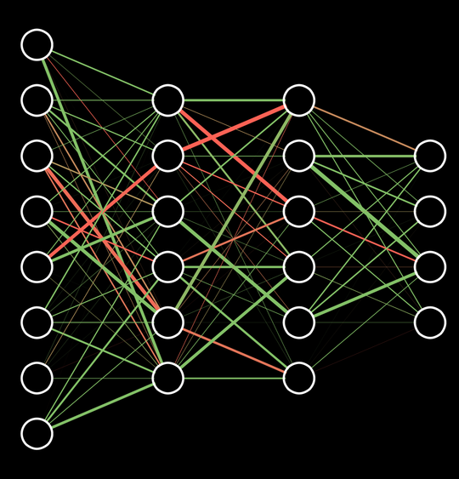
MLG06 Apprentice Cohort
Day 5: Data Visualization 101

Slide 2
Data Vis 101 Schedule
Introductions
Why?
General principles
Which chart when
Overview of charts
Survey of tools
Notes:
Talk about how what the purpose of the presentation

Slide 3
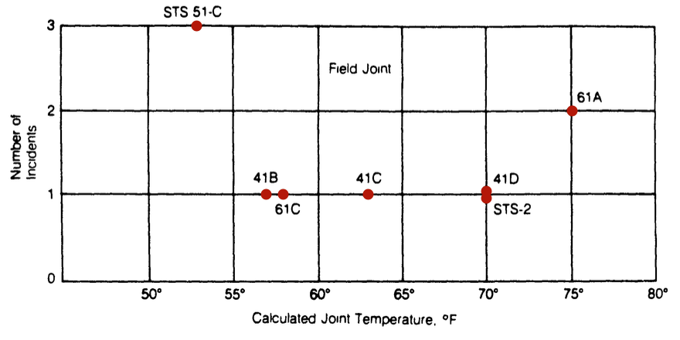
Introduction
Why does data visualization matter?
For all the sophisticated analysis we can conduct, it’s easy to miss trends in data unless we actually look at it. Good visualization develops intuition for potential approaches we could take in EDA, guides us throughout model development, and elevate the results and findings of our analysis. Bad visualization can lead to underperforming models and poor decision making.

Slide 4
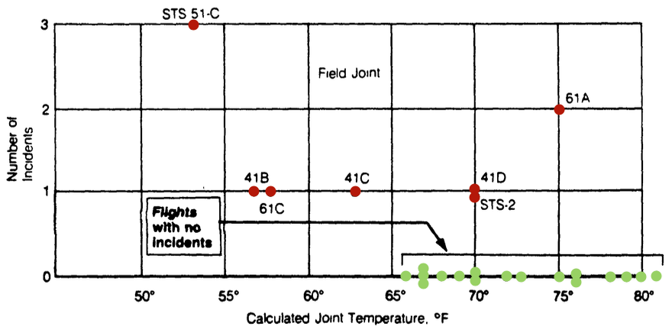
Introduction
Why does data visualization matter?
For all the sophisticated analysis we can conduct, it’s easy to miss trends in data unless we actually look at it. Good visualization develops intuition for potential approaches we could take in EDA, guides us throughout model development, and elevate the results and findings of our analysis. Bad visualization can lead to underperforming models and poor decision making.

Slide 5
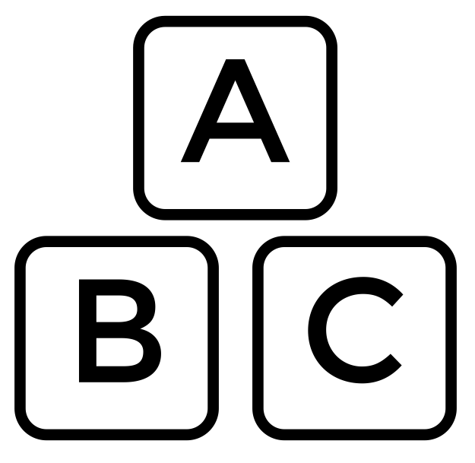
Content and Aesthetics
How make effective charts
The blend of content and aesthetics is what makes data visualization part science and part art. The following tips will help ensure honest and impactful data visualization
Know your data
Plot your zeros
Tell a story
Keep it simple
Consider the user
Size, shape, and color are tools
3D Charts are misleading
Order your legend logically
Use the right chart
Pie charts are awful

Slide 6
Content and Aesthetics
When to use which chart
Depending on the data relationship you’re trying to investigate or highlight, there are different charts that are better suited to the task.
Relationship | Description | Charts
Nominal Comparisons | Absolute comparisons of measures between categories | Bar, Column
Relative Comparisons | Normalized comparisons of measures between categories | 100% Stacked Bar 100% Stacked Column, Heat maps
Time Series | Track changes over time | Line, area
Correlation | Observe relationship between two or more variables | Scatter plot, bubble
Distribution | Show the dispersion of data, how often value occur | Histogram, KDE, Violin plot
Part of whole | Shows decomposition of whole set into subsets | Area plot, stacked bar

Slide 7
Charts – Bar and Column
Bar charts and column charts are generally synonymous, though column charts are always oriented vertically.
VERTICAL (COLUMN CHART)
Best used for chronological data (time-series should always run left to right), or when visualizing negative values below the x-axis.
HORIZTONAL
Best used for data with long category labels.

Slide 8
Charts – Bar and Column (Stacked)
Bar charts and column charts are generally synonymous, though column charts are always oriented vertically.
STACKED
Best used when there is a need to compare multiple part-to-whole relationships. These can use discrete or continuous data, oriented either vertically or horizontally.
100% STACKED
Best used when the total value of each category is unimportant and percentage distribution of subcategories is the primary message.

Slide 9
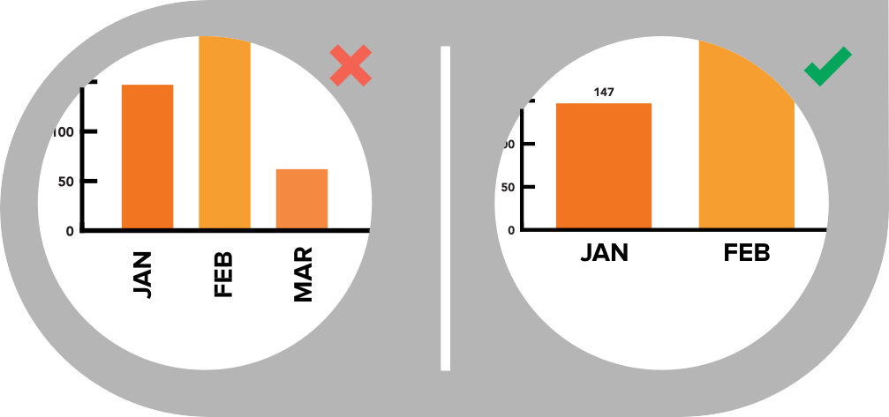


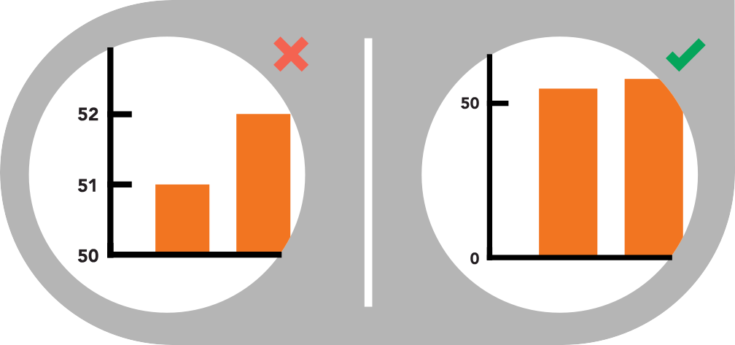
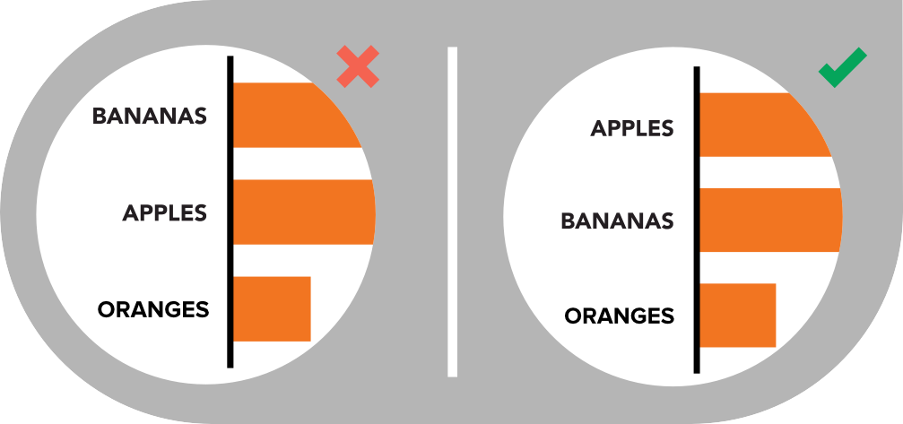
Charts – Bar and Column (best practices)
USE HORIZONTAL LABELS
Avoid steep diagonal or vertical type, as it can be difficult to read.
SPACE BARS APPROPRIATELY
Space between bars should be ½ bar width.
START THE Y-AXIS VALUE AT 0
Starting at a value above zero truncates the bars and doesn’t accurately reflect the full value.
USE CONSISTENT COLORS
Use one color for bar charts. You may use an accent color to highlight a significant data point.
ORDER DATA APPROPRIATELY
Order categories alphabetically, sequentially, or by value.

Slide 10
Charts – Line Charts
Line charts are used to show time-series relationships with continuous data. They help highlight trends, acceleration, deceleration, and volatility.

Slide 11
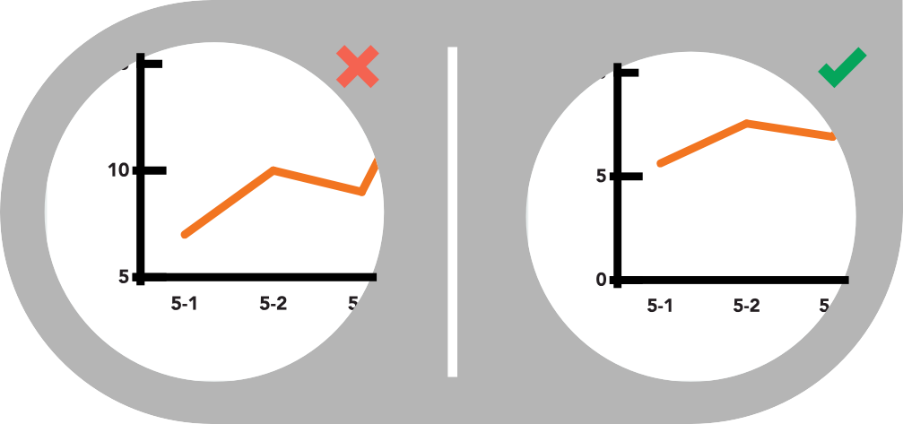

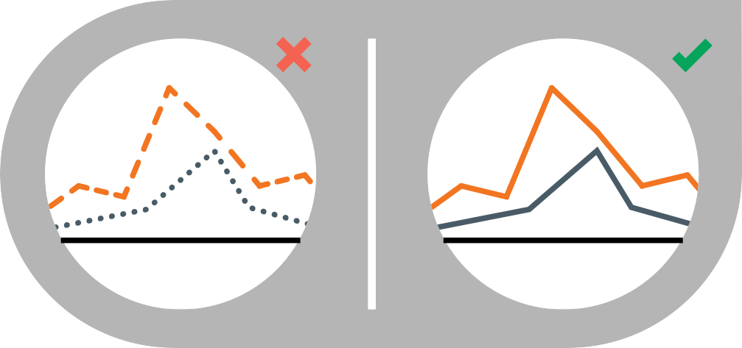

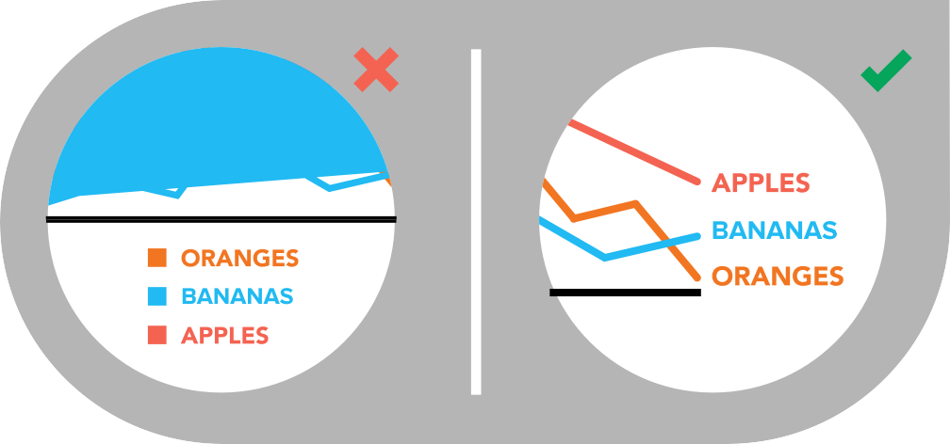
Charts – Line Charts (best practices)
INCLUDE A ZERO BASELINE IF POSSIBLE
Although a line chart does not have to start at a zero baseline, it should be included if possible. If relatively small fluctuations in data are meaningful (e.g., in stock market data), you may truncate the scale to showcase these variances.
DON’T PLOT MORE THAN 4 LINES
If you need to display more, break them out into separate charts for better comparison.
USE SOLID LINES ONLY
Dashed and dotted lines can be distracting.
LABEL THE LINES DIRECTLY
This lets readers quickly identify lines and corresponding labels instead of referencing a legend.
USE THE RIGHT HEIGHT
Plot all data points so that the line chart takes up approximately two-thirds of the y-axis’ total scale.

Slide 12
Charts – Area Charts
Area charts depict a time-series relationship, but they are different than line charts in that they can represent volume.
AREA CHART
Best used to show or compare a quantitative progression over time.
STACKED AREA
Best used to visualize part-to-whole relationships, helping show how each category contributes to the cumulative total.
100% STACKED AREA
Best used to show distribution of categories as part of a whole, where the cumulative total is unimportant.

Slide 13

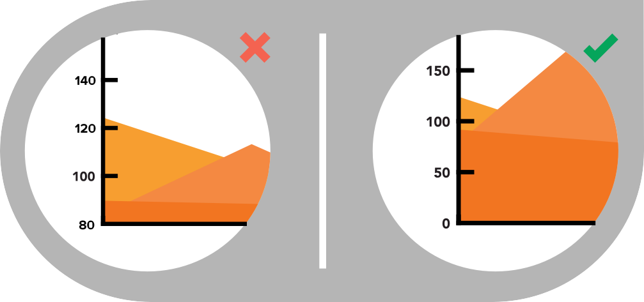
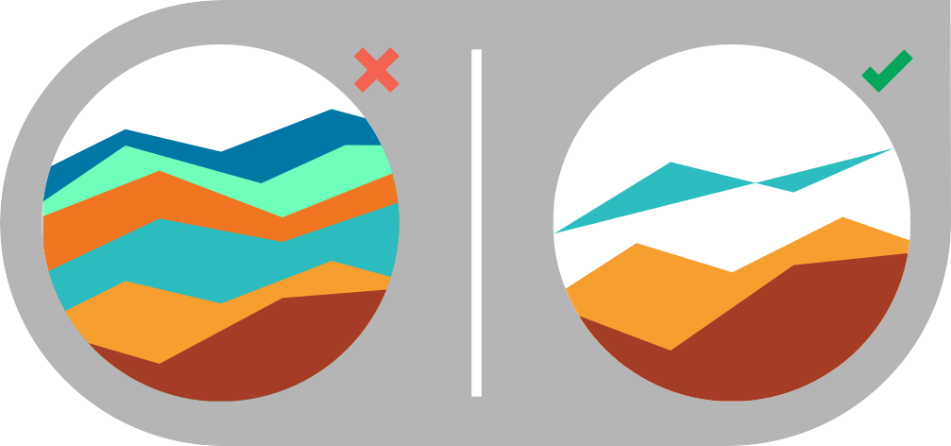

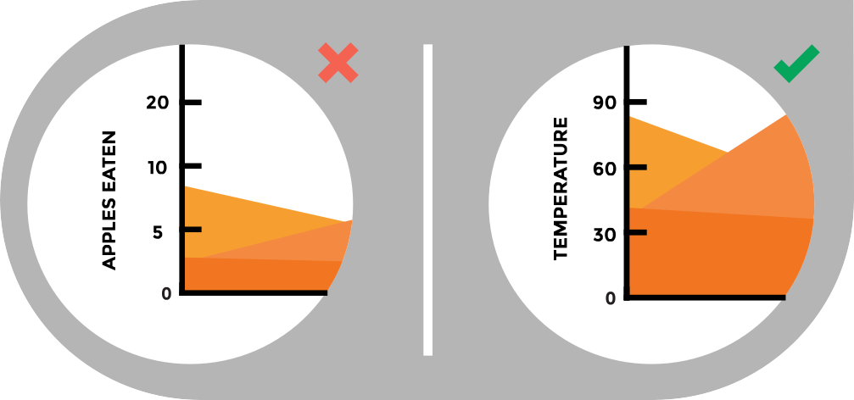
Charts – Area Charts (best practices)
MAKE IT EASY TO READ
In stacked area charts, arrange data to position categories with highly variable data on the top of the chart and low variability on the bottom.
START Y-AXIS VALUE AT 0
Starting the axis above zero truncates the visualization of values.
DON’T DISPLAY MORE THAN 4 DATA CATEGORIES
Too many will result in a cluttered visual that is difficult to decipher.
USE TRANSPARENT COLORS
In standard area charts, ensure data isn’t obscured in the background by ordering thoughtfully and using transparency.
DON’T USE AREA CHARTS TO DISPLAY DESCRETE DATA
The connected lines imply intermediate values, which only exist in continuous data

Slide 14
Charts – Scatter Plots
Scatter plots show the relationship between items based on two or more sets of variables. They effectively compare two or more data points with a large volume, revealing trends not shown through aggregate measures.

Slide 15




Charts – Scatter Plots (best practices)
START Y-AXIS VALUE AT 0
Starting the axis above zero truncates the visualization of values.
INCLUDE MORE VARIABLES
Use size and dot color to encode additional data variables.
DON’T COMPARE MORE THAN 2 TREND LINES
Too many lines make data difficult to interpret.

Slide 16
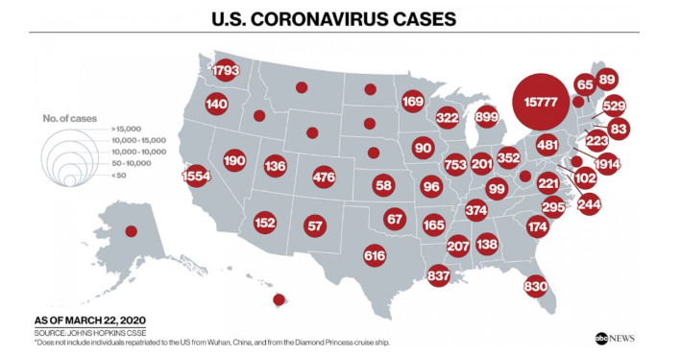
Charts – Bubble Charts
Bubble charts are good for displaying nominal comparisons within other charts.

Slide 17
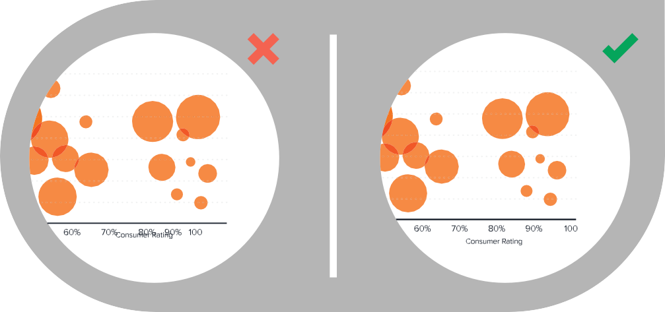
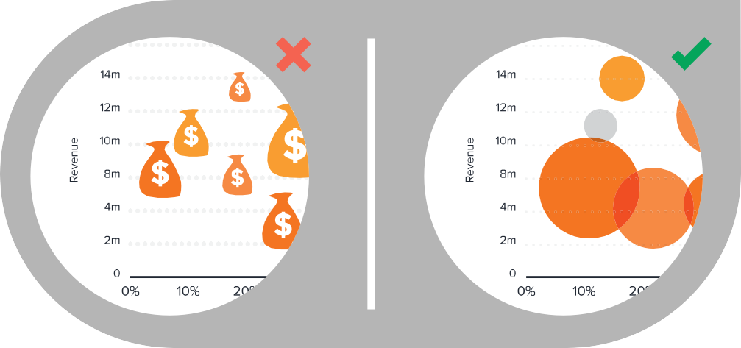
Charts – Bubble Charts (best practices)
MAKE SURE LABELS ARE VISIBLE
All labels should be unobstructed and easily identified with the corresponding bubble.
SIZE BUBBLES APPROPRIATELY
Bubbles should be scaled according to area, not diameter.
DON’T USE ODD SHAPES
Avoid adding too much detail or using shapes that are not entirely circular; this can lead to inaccuracies.

Slide 18
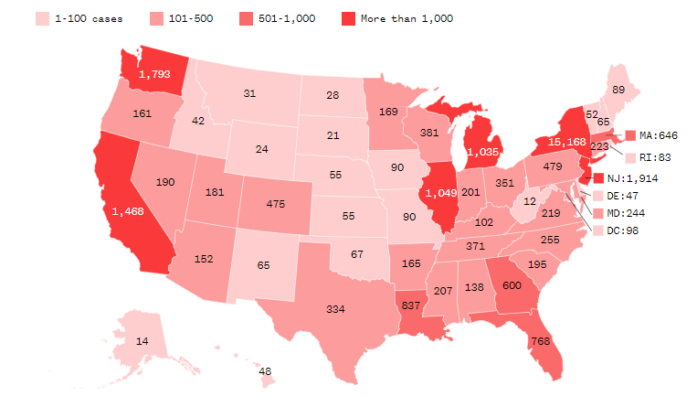
Charts – Heat Maps
Heat maps display categorical data using color intensity to represent values of geographic areas or data tables.
Reported cases of Coronavirus as of 3/22/20

Slide 19
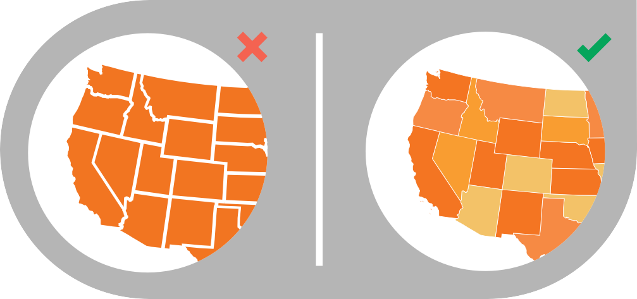
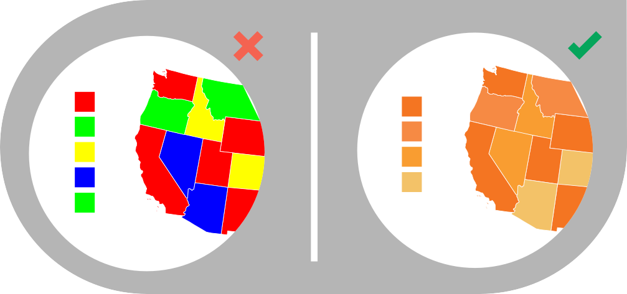
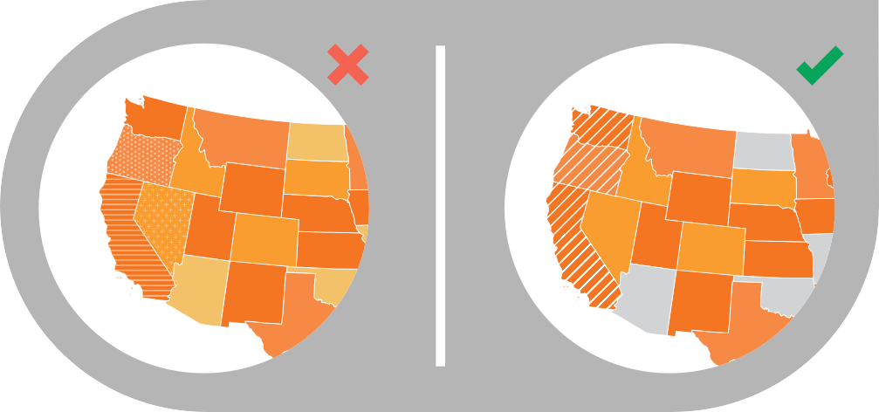
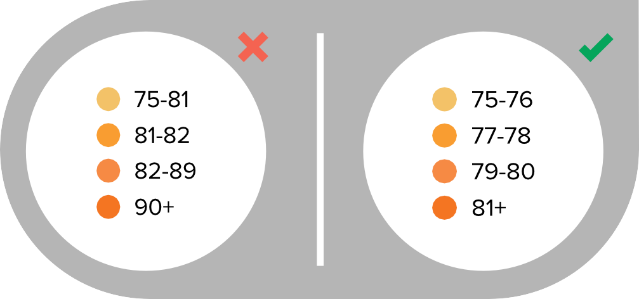
Charts – Heat Maps (best practices)
WA
MT
ND
OR
ID
WY
SD
CA
NV
UT
CO
NE
KS
AZ
NM
USE A SIMPLE MAP OUTLINE
These lines are meant to frame the data, not distract.
SELECT COLORS APPROPRIATELY
Some colors stand out more than others, giving unnecessary weight to that data. Instead, use a single color with varying shade or a spectrum between two analogous colors to show intensity. Also remember to intuitively code color intensity according to values.
USE PATTERNS SPARINGLY
A pattern overlay that indicates a second variable is acceptable, but using multiple is overwhelming and distracting.
CHOOSE APPROPRIATE DATA RANGES
Select 3-5 numerical ranges that enable fairly even distribution of data between them. Use +/- signs to extend high and low ranges.

Slide 20
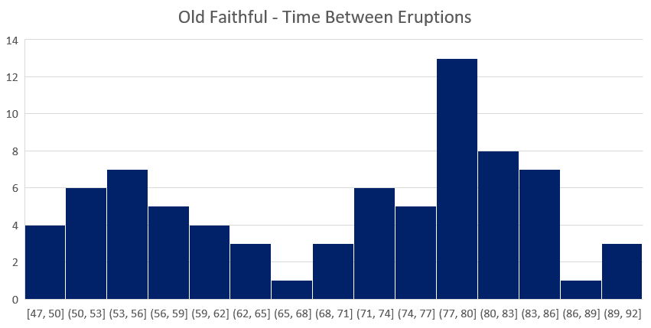
Charts – Histograms
Histograms visualize the distribution of data over it’s support, individual observations are binned into consecutive non-overlapping buckets and frequency of bins is plotted. They can provide understanding of data that are masked by aggregate measures.

Slide 21
3D Charts
Why they’re misleading
The angle of the chart make comparisons difficult. The purpose of charts is to compare values or see relationships and when a disproportionate amount of ink is spent on the other angles, it is misleading to the viewer.

Slide 22
3D Charts
Why they’re misleading
The angle of the chart make comparisons difficult. The purpose of charts is to compare values or see relationships and when a disproportionate amount of ink is spent on the other angles, it is misleading to the viewer.

Slide 23
Pie Charts
Which line is bigger?

Slide 24
Pie Charts
Which line is bigger?

Slide 25
Pie Charts
Which line is bigger?

Slide 26
Pie Charts
Which line is bigger?

Slide 27

Pie Charts
Which line is bigger?

Slide 28
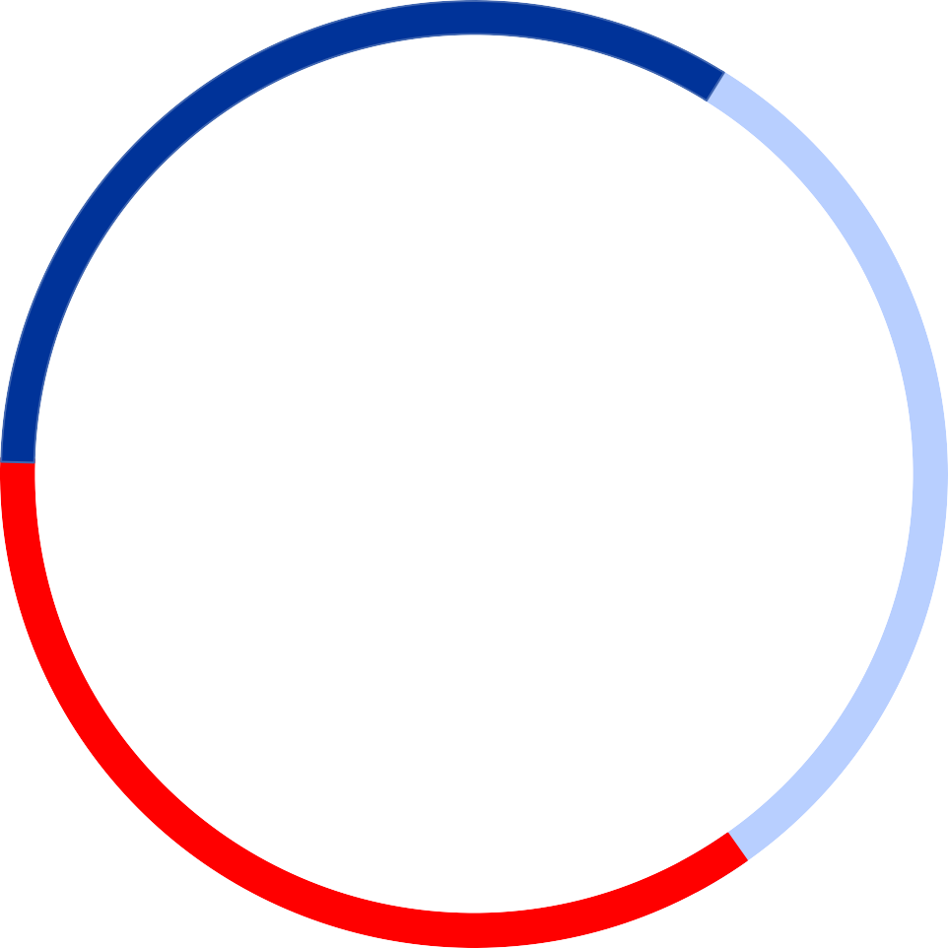
Pie Charts
Which line is bigger?

Slide 29
Pie Charts
Which fan is bigger?

Slide 30
Pie Charts
Which fan is bigger?

Slide 31
Pie Charts
Which charts is more clear?

Slide 32
Visualization Tools – Plotly Dash
General Info
Plotly dash is a visualization and dashboarding framework for Python built with Flask, Plotly.js, and React. It allows for development with pure Python.
Plotly is a Python/R/JavaScript package which is very similar functionality to ggplot2 or matplotlib, but with hover over capability. Dash is an open source tool enabling web hosting of interactive visualizations built with Plotly. Plotly dash has a relatively large and rapidly growing userbase, along with extensive
The Machine Learning Guild has previously included Plotly Dash specific training in the apprentice training, and those materials are included on the GitHub page in the “additional_materials” folder.
Relevant Links:
https://dash.plot.ly/
https://dash-gallery.plotly.host/Portal/

Slide 33
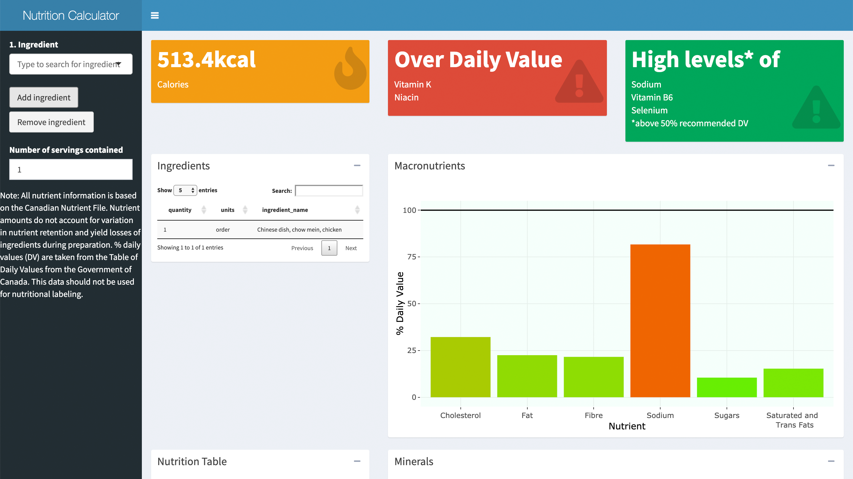
Visualization Tools – Rshiny
General Info
Shiny is a package for R that allows construction of interactive web applications coded in a combination of R, CSS, HTML, and JavaScript.
RShiny is free, has an active development community, and is very customizable. However, RShiny does suffer from many of the same large data volume problems that R has
Useful links:
https://shiny.rstudio.com/tutorial/
https://shiny.rstudio.com/gallery/

Slide 34
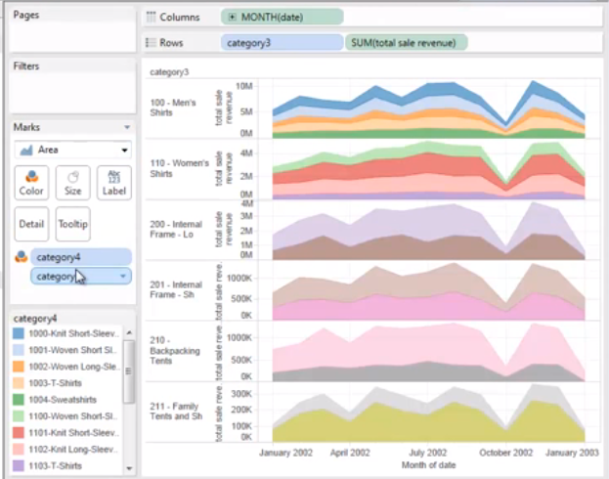
Visualization Tools – Tableau
General Info
Tableau is a drag and drop dashboard software that is very popular in business intelligence analytics. By default, Tableau has minimal machine learning capability, but in recent years it has added integration with both R and Python.
Deloitte currently has Tableau licenses available depending on practitioner practice area and service line. Deloitte also maintains a Tableau server for hosting internal projects.
Relevant links:
https://www.tableau.com/learn/training/20201
https://public.tableau.com/en-us/gallery

Slide 35
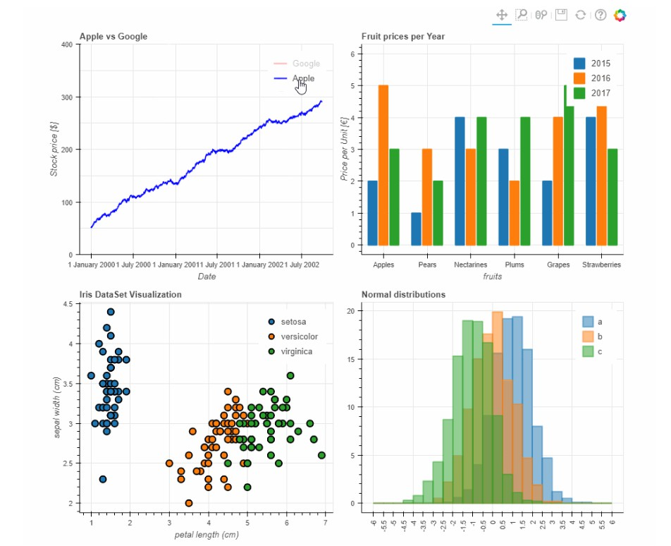
Visualization Tools – Bokeh
General Info
Bokeh is a python library enabling interactive visualization integrated with web browsers. Bokeh allows use of HTML, JavaScript, and Python.
While Bokeh is a flexibile framework, it does lack the userbase and options that other visualization software do have. Bokeh is still in relatively early stage of development and there exist many known and unsolved issues.
Relevant links:
Setup & Tutorial Notebook
https://docs.bokeh.org/en/latest/docs/gallery.html

Slide 36
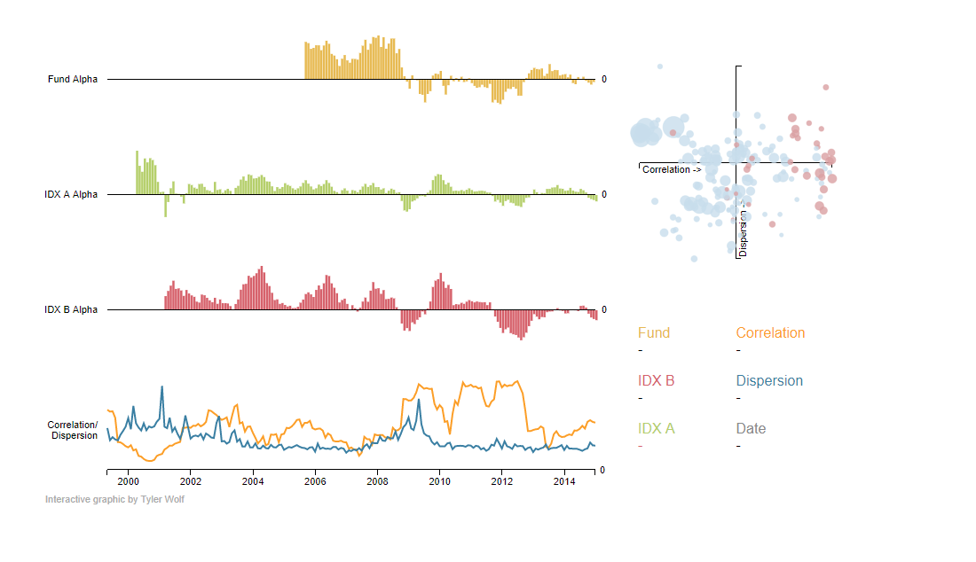
Visualization Tools – D3.js
General Info
D3 is a JavaScript library for interactive data visualization. It has an extensive userbase, is highly customizable, and has the largest number of distinct types of charts available.
However, D3 is a combination of JavaScript, CSS, and HTML. Python can interface with D3 through flask, but there is still extensive development with JavaScript required.
Relevant links:
https://github.com/d3/d3/wiki/Tutorials
https://github.com/d3/d3/wiki/Gallery

